Slide 1



Introduction to Machine Learning(CS182)
Project
Sentiment analysis of bullet screen
汇报人：王柯皓 于曾旭 吴子阳
时间：2024年1月4日

Slide 2
01
Backgrounds
02
Contents
Algorithm
03
Future Direction

Slide 3
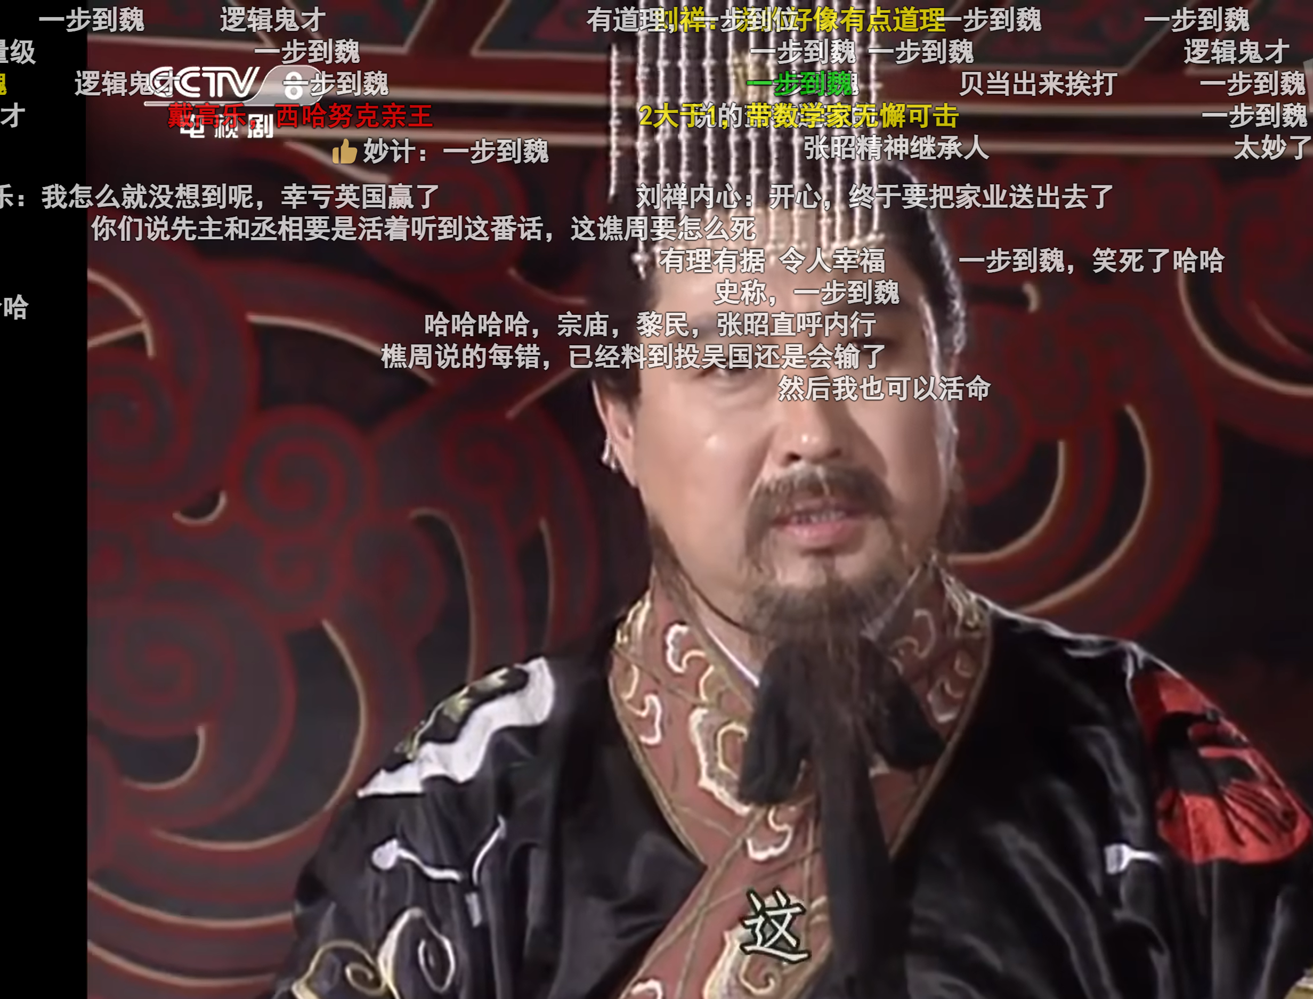
PART 01
Backgrounds

Slide 4
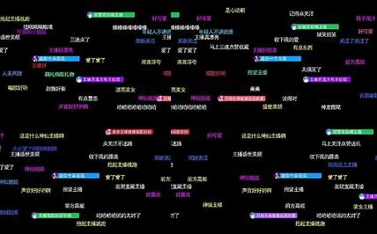



Background Analysis
"Bullet screen" is a popular form of interactive online video discussion in China.
With the development and maturity of video websites and video publishing websites, video barrage has become more and more common.
short videos and live streaming are widely available
It is an innovative video technology, which fills the technical gap between video and network video, realizes all-media interaction in the true sense, promotes the emerging research, communication, discussion and other forms of expression between video and network video, forms the concept of popular culture activity, and also drives the research on emotion analysis of text.
The number of users has increased
It is easier to express emotions online

Slide 5

PART 02
Algorithm

Slide 6
Project process
Obtain data, merge data, clean data (including deleting invalid fields, splitting statements, etc.).
①
Use different algorithms to classify valid data that has been processed.
②
Record the time consumption and accuracy of different classification algorithms, and compare the pros and cons of various algorithms.
③

Slide 7
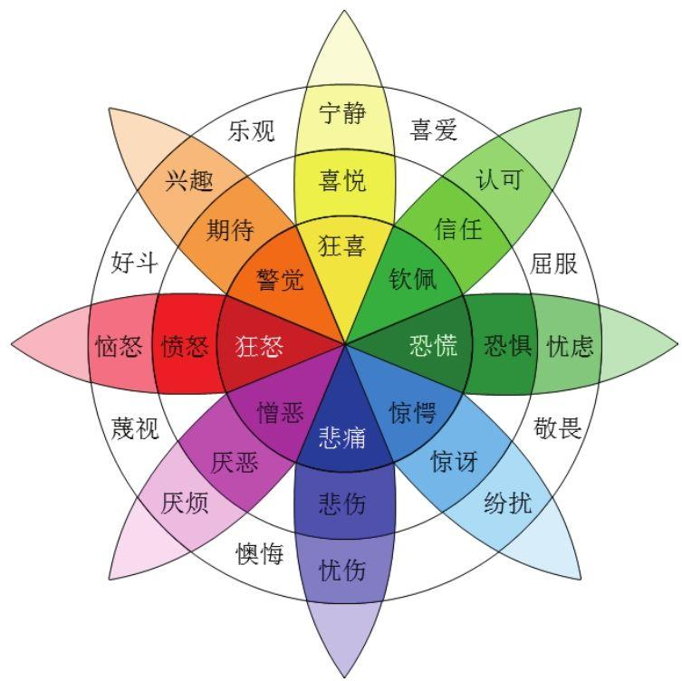

Two mainstream methods
Method
based on
emotional dictionary
Method
based on
machine learning

Slide 8
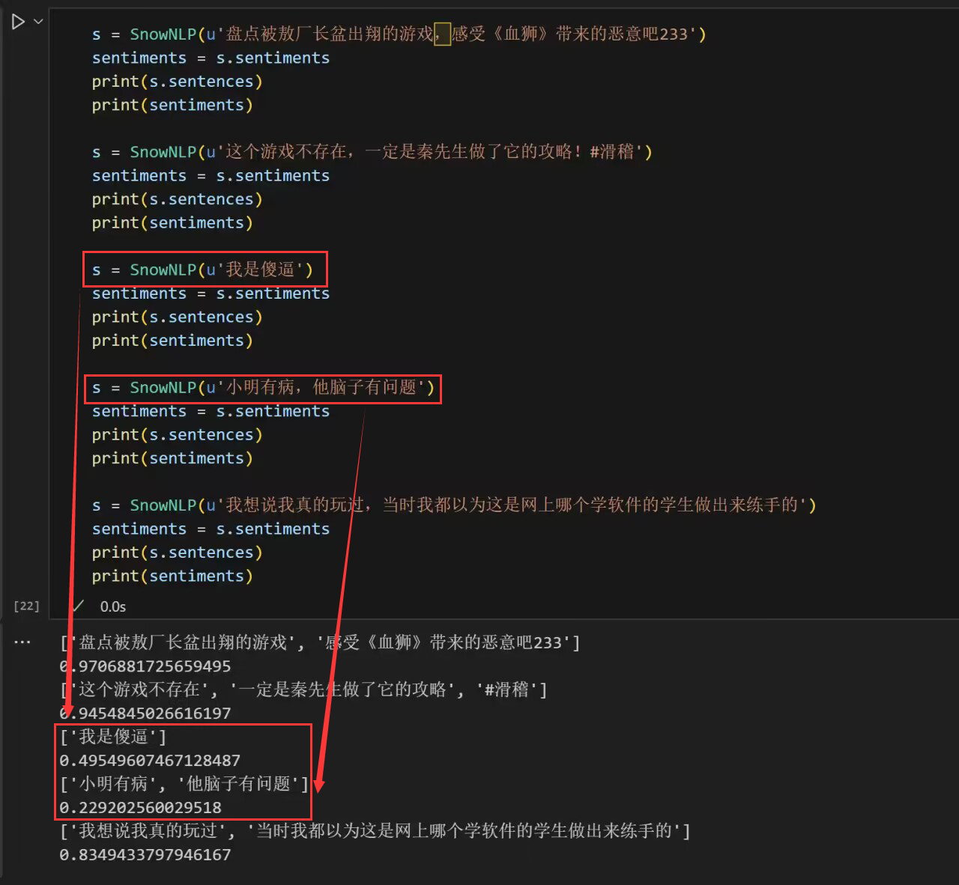
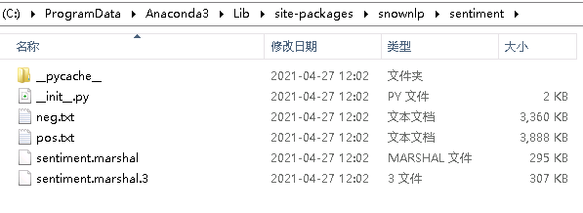
Emotional dictionary(Preliminary experiments)
Use snownlp to assist training data sets
SnowNLP will calculate the probability that the text semantics is close to positive. The closer it is to 0, the more negative the sentiment will be, and the closer it is to 1, the more positive the sentiment will be.

Slide 9
Methods based on machine learning
Commonly used features: bag-of-words model, TF-IDF and word vectors
01
k-NN
Pros:simple and efficient;
Cons:low accuracy.
Pros:easy to implement;
Cons:time intensive & memory intensive.
Bayes classifier
02
Pros:high accuracy;
Cons:training is time intensive.
03
SVM
Maximum Entropy Model
Pros:high accuracy;
Cons:training is time intensive.
04

Slide 10
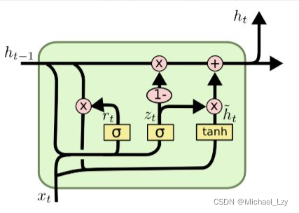
05. GRU
Pro:the model is simple, with fewer parameters, faster training and higher efficiency.
Cons:cannot completely solve the vanishing gradient problem; difficult to deal with models with large amounts of data.

Slide 11

Comparison of algorithm effects：
Positive words
precision
1. Classification Accuracy
2. Time Consumption
Negative words
precision

Slide 12

PART 03
Future Direction

Slide 13
Future Direction
Irrelevant word filtering/popular word meaning differentiation
In the preliminary practice, we will find that some words will be expressed by the way of homophony on the network, but the semantic ambiguity of these words in the implementation process will lead to wrong judgment and even affect the subsequent training results. At the same time, many words lack practical meaning. In the subsequent process, we added screening before classification to improve the accuracy.
Video theme analysis
Consistency: Is the emotion in the barrage consistent with the theme of the video? Do viewer comments emotionally match the content of the video? Consistency analysis: Are sentiment analysis results consistent throughout the video? Or does it change as the plot of the video progresses?
Hot comment analysis:Are there hot comments in the barrage, comments that are mentioned or liked by a large number of viewers? We can make more scientific classification by increasing the weight ratio and so on
Step
01
Step
02
Step
03
Video recommendation
Sentiment analysis in bullet screen can provide more accurate information for per-sonalized recommendation. Understanding viewers' real-time emotional responses
to videos helps platforms better understand user preferences and interests. By incorporating the results of sentiment analysis into the recommendation algorithm, the platform can more finely adjust the recommended content to meet the emotional needs of users.

Slide 14
Introduction to Machine Learning(CS182)
Project
“
Thanks
汇报人：王柯皓 于曾旭 吴子阳
时间：2024年1月4日
”

